Slide 1
BM329 workshop B
Dr. Morgan Feeney & Prof. Paul Hoskisson

Slide 2
Learning Objectives
After this workshop, students will be able to:
Describe influenza virus particles and how they replicate
Explain the role that antigenic shift and antigenic drift play in influenza virus evolution
Discuss the effects of vaccination and antiviral drugs on influenza virus evolution and public health
Build phylogenetic trees representing the evolution of influenza viruses

Slide 3
Influenza virus causes seasonal and pandemic flu
Negative-strand RNA virus; orthomyxovirus
Virion has helical symmetry, but in reality amorphous appearance
Segmented genome
8 separate RNAs, 890-2341 nucleotides
Influenza A, B & C
Influenza A is key cause of ‘flu [seasonal ‘flu kills avg. 400k/year; pandemic ‘flu can kill millions more]
Influenza A subtypes based on H and N proteins
Hemagglutinin (H1 – 18): Sialic acid binding protein (lectin), key determinant of host specificity
Neuraminidase (N1 – 11): Sialidase, key role in virus assembly
H1N1 and H3N2 are most common circulating subtypes that cause disease in humans

Slide 4
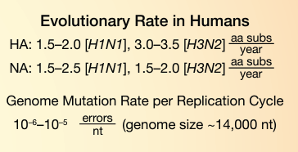
Influenza virus replication
Negative sense mRNA virus
RNA-dependent RNA polymerase – no proofreading
8 genome segments – must be packaged correctly to form an infectious virion

Slide 5
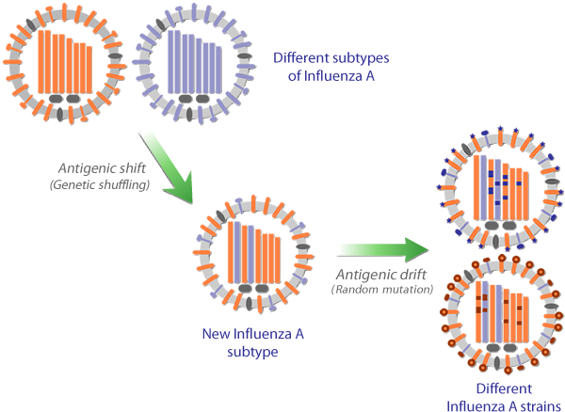
Virus evolution by antigenic shift and antigenic drift

Slide 6
Workshop instructions
Overview:
Assemble viral particles
Infect a new host, virus reproduces → assemble new particles
→if you encounter a mutation, you must add this to your viral genome
Switch to a new host, repeat step 2. (x times)
Build a phylogenetic tree representing the evolution of your ‘flu viruses in your group
TBD: how many rounds of infection should we have them do?

Slide 7
Infection Round 1
This round will demonstrate ‘flu evolution via antigenic drift & shift

Slide 8
Step 1: You have been infected! Assemble a viral particle
You will need 1 virus capsid (envelope) and 8 virus genome segments (strips of paper).
Make sure you record your starting genome state on the handout!

Slide 9
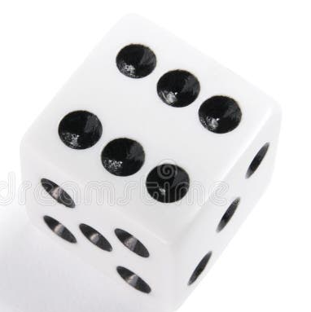
Step 2: Infect a new host
Infection outcome?
Pass the virus to the person sitting next to you
For each infection, roll a die to determine the outcome:
Roll | Outcome
1 | Pre-existing immunity: virus does not infect/replicate
2 | Infection: record genome & pass on to next person
3 | Co-infection! [draw a new virus packet, mix → assemble new viral genome, record genome and pass on to next person]
4 | Infection: record genome & pass on to next person
5 | Infection: record genome & pass on to next person
6 | superspreader! virus infects and replicates [record genome and pass on to 2 people]
For a successful infection (roll 2-6), add a mutation to one of your virus genome segments [select 1 segment at random & change its allele # + .1 (e.g., PB2 – 1 → PB 2 – 1.1)

Slide 10
Step 3: Build a phylogenetic tree
TBD: add steps for how to do this

Slide 11


Slide 12
Infection Round 2
This round will demonstrate the effect of vaccination on ‘flu infection and evolution

Slide 13
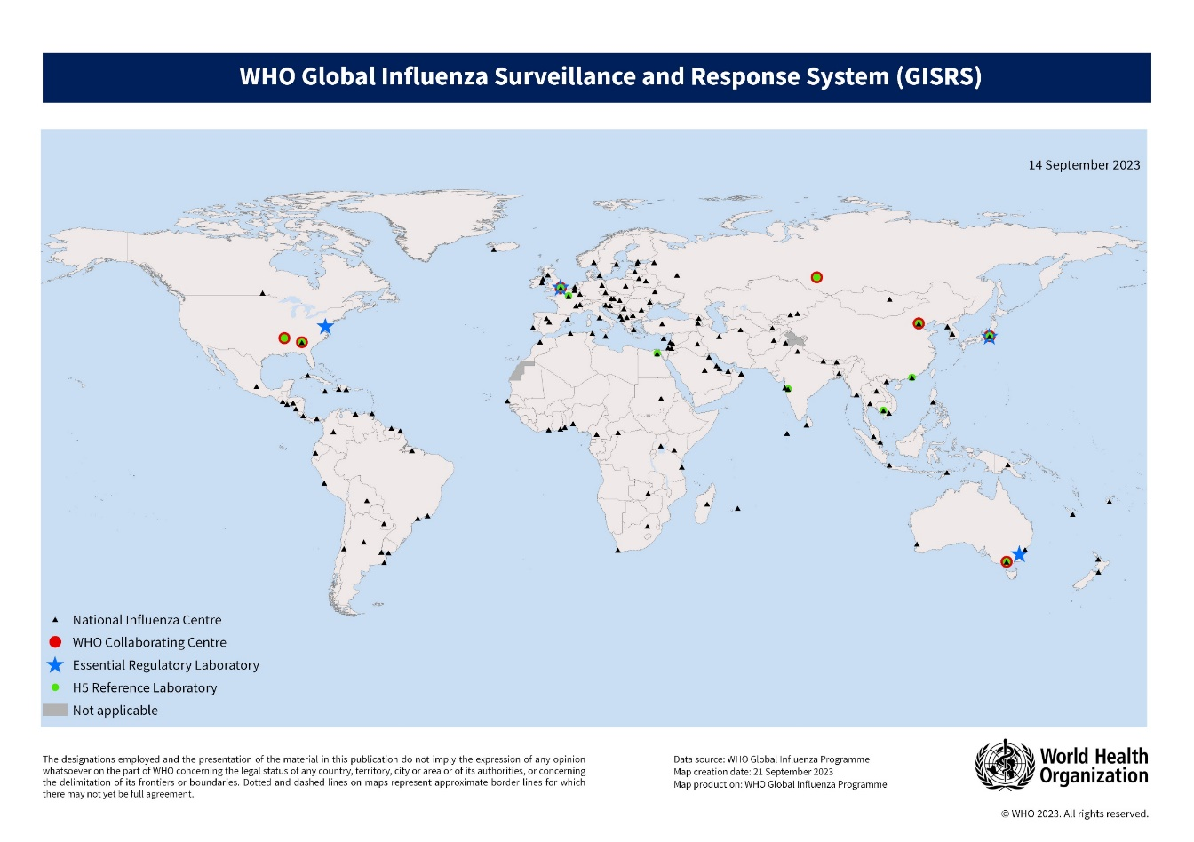
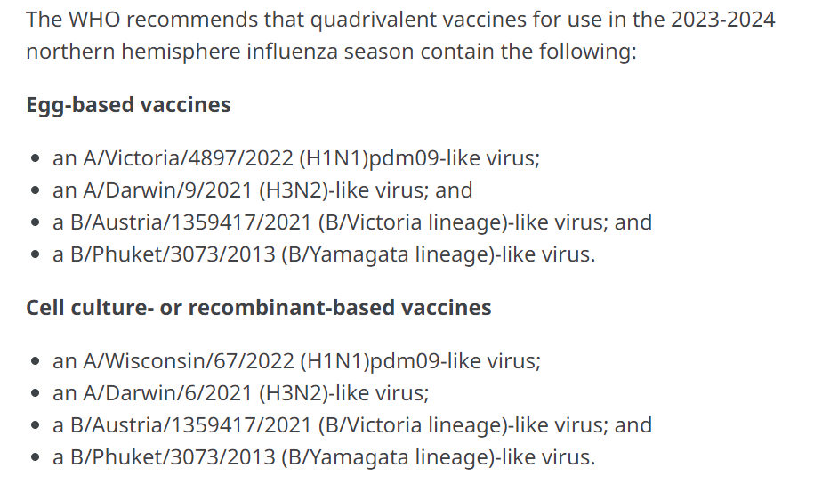
Influenza surveillance and response (WHO)
Global monitoring identifies major circulating strains
WHO panel meets to appraise evidence and recommendations from GISRS
Strains for that year’s vaccine are selected: Feb (Northern hemisphere), Sep (Southern hemisphere)
Sent to vaccine manufacturers
Vaccines prepared for use in the flu season
If a novel strain appears subsequent to this, vaccine unlikely to be protective

Slide 14
Our GISRS group must decide, based on evidence, which influenza strains to include in the vaccines for the coming ‘flu season
Choose 2 influenza A subtypes (other 2 in the quad. vaccine will be B types)

Slide 15
Infection Round 2
Roll 1: infection?
Roll 2: outcome?
Repeat virus evolution with new rules:
Roll a die to determine if you are infected or not.
vaccine-derived immunity: vaccine subtypes do not infect/replicate; virus types not found in the vaccine can still infect/replicate
If infected, roll again to determine the outcome of the infection. (Continue to add mutations as usual)
 | First roll of the die | Second roll of the die
1 | Pre-existing immunity | Virus replicates as normal (record genome & pass on)
2 | Infection | Co-infection! (draw another virus & reassort)
3 | Infection | Virus replicates as normal (record genome & pass on)
4 | Vaccine-derived immunity (immune IF virus type in vaccine) | Virus replicates as normal (record genome & pass on)
5 |  | Virus replicates as normal (record genome & pass on)
6 | Infection | Superspreader! (pass on to X people)

Slide 16
Add another round here if we think there will be enough time?
Idea – give each group a “budget” (packet of sweeties/similar)
They can use the sweets to “buy” extra vaccine doses on the dice, or to buy antiviral drugs … or they can choose to keep the sweets (for future need, or to eat….?)

Slide 18
Infection Round 3
This round will demonstrate the “mixing bowl” theory and how zoonotic infections influence ‘flu evolution

Slide 19
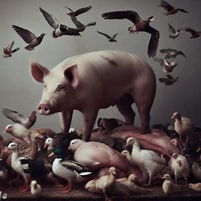
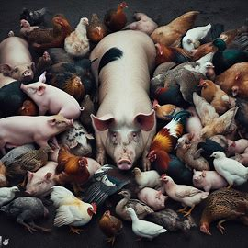
Swine and bird flu
Image credit: Microsoft Bing

Slide 20
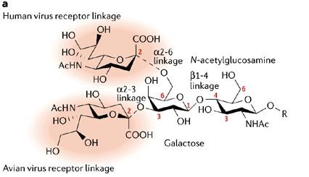
Hemagglutinin specificity and the “mixing bowl” theory
H1N1 (human) viruses: bind α-2,6 linked sialic acid
The major linkage in human respiratory epithelia
Some α-2,3 linked sialic acid is present
H5N1 (avian): bind α-2,3 linked
The major linkage in the e.g. duck gut
Pig trachea: both linkages present
Co-infection with H1N1 and H5N1 could occur in pigs or humans
Recombination with flu/swine flu
(“mixing bowl” theory) → generate new variants (potentially more deadly, pandemic strains)

Slide 21
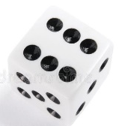
Zoonotic ‘Flu Viruses
Roll 1: animal contact?
Roll 2: infection?
Roll 3: outcome?
Repeat virus evolution with new rules:
Roll a die to determine if you have come in contact with an infected animal and contracted a zoonotic strain of ‘flu.
Combine this with the usual rolls for a human-derived ‘flu virus from someone in your group). If co-infected in roll 2, reassort genome segments randomly to build a new virus).
 | First roll | Second roll | Third roll
1 | No animal contact | Pre-existing immunity | Virus replicates as normal (record genome & pass on)
2 | Animal contact (draw a random genome) | Infection | Co-infection! (draw another virus & reassort)
3 | No animal contact | Infection | Virus replicates as normal (record genome & pass on)
4 | No animal contact | Vaccine-derived immunity (immune IF virus type in vaccine) | Virus replicates as normal (record genome & pass on)
5 | No animal contact |  | Virus replicates as normal (record genome & pass on)
6 | No animal contact | Infection | Superspreader! (pass on to X people)

Slide 22
Compare phylogenetic trees
Share your phylogenetic trees to compare how evolution has occurred in different groups for all three rounds
Discuss:
How well do the phylogenetic trees you have drawn reflect ‘flu evolution in the different scenarios? How do these compare to evolution in the real world?
How might the next pandemic strain of ‘flu evolve?

Slide 23
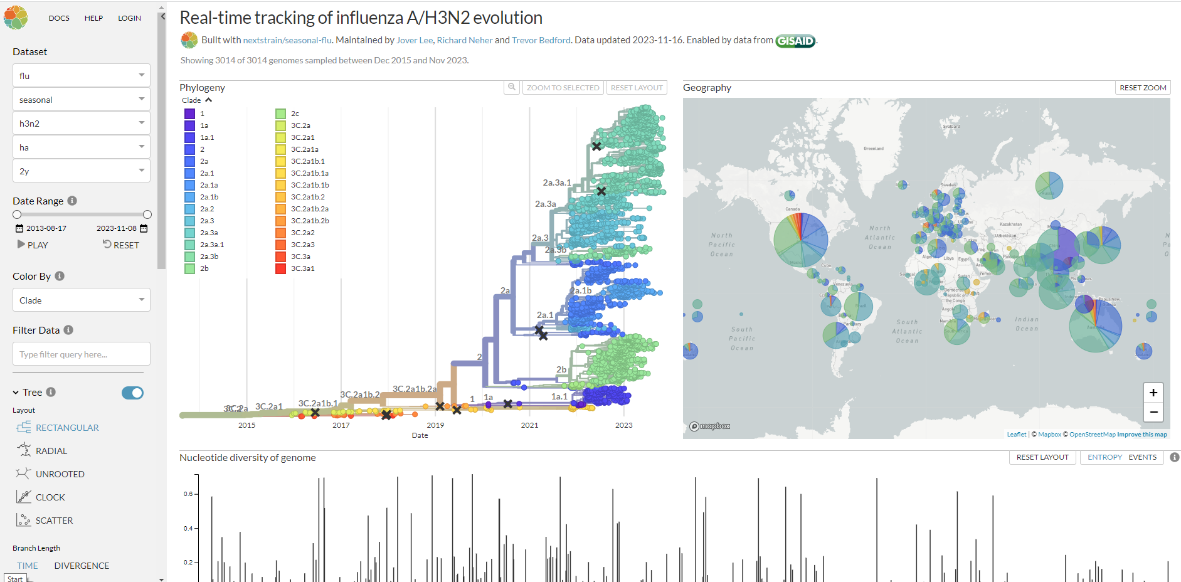

Slide 24
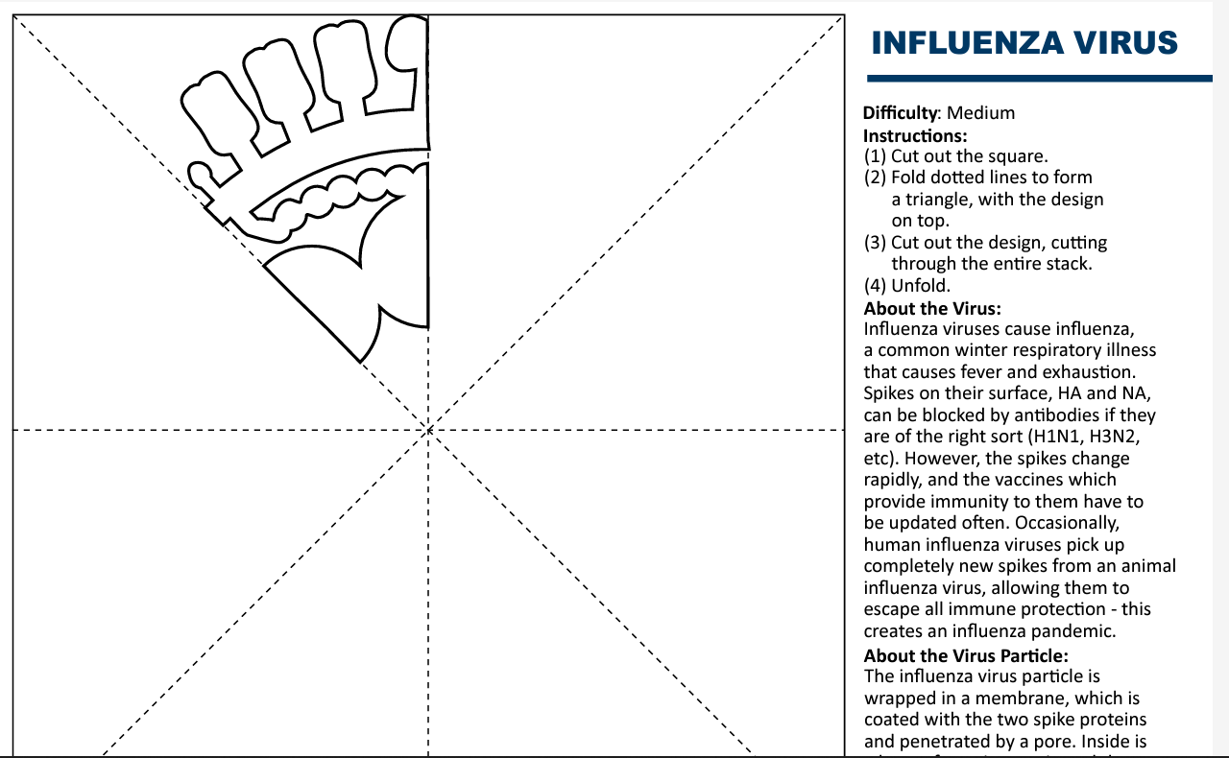
Further reading
Petrova VN, Russell CA. The evolution of seasonal influenza viruses. Nat Rev Microbiol. 2018;16(1):47-60. doi:10.1038/nrmicro.2017.118
Han AX, de Jong SPJ, Russell CA. Co-evolution of immunity and seasonal influenza viruses. Nat Rev Microbiol. 2023;21(12):805-817. doi:10.1038/s41579-023-00945-8
Chen KY, Karuppusamy J, O'Neill MB, et al. High-throughput droplet-based analysis of influenza A virus genetic reassortment by single-virus RNA sequencing. Proc Natl Acad Sci U S A. 2023;120(6):e2211098120. doi:10.1073/pnas.2211098120
Xie R, Edwards KM, Wille M, et al. The episodic resurgence of highly pathogenic avian influenza H5 virus. Nature. 2023;622(7984):810-817. doi:10.1038/s41586-023-06631-2
Dzau V, Yadav P. The influenza imperative: we must prepare now for seasonal and pandemic influenza. Lancet Microbe. 2023;4(4):e203-e205. doi:10.1016/S2666-5247(23)00013-7
FluNet: https://www.who.int/tools/flunet
NextStrain: https://nextstrain.org/flu/seasonal/h3n2/ha/2y
Make your own influenza virus snowflake →
https://cvr-engagement.co.uk/virus-snowflakes

